Slide 1

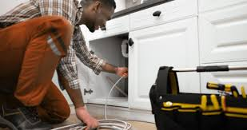
Essential Artisans
By Salaudeen Bimbo

Slide 2
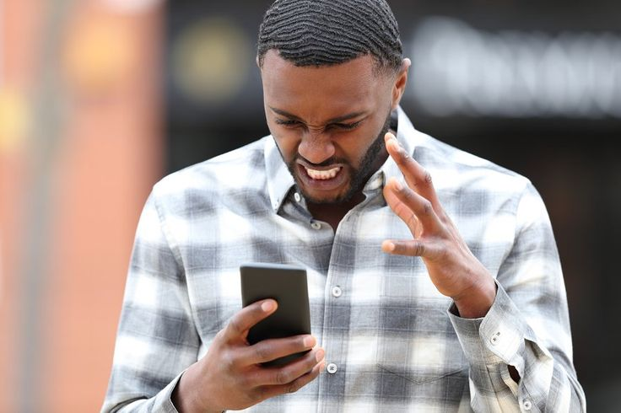
The Problem
People living in Lekki find it challenging to get artisans due to their busy schedules.
Residing in gated estates makes it difficult for them to access artisans conveniently from their homes.
Residents often face challenges finding artisans who are both reliable and trustworthy. Many have had previous experiences with artisans who either did not meet quality expectations or failed to complete tasks as promised.

Slide 3

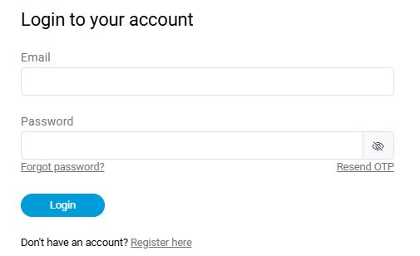
The Solution
Our solution is designed to provide reliable repair services and simplify scheduling. Through our web application, residents can easily connect with a team member to arrange services conveniently.
“

Slide 4
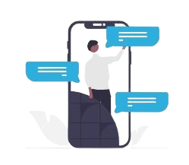

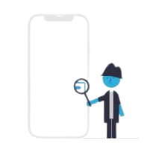

Product
Our product is
Web Based Application
1. Create account
2. Book an Inspection
3. Get the Job done

Slide 5
Target Market
Our target market consists of residents in Lekki, Lagos
4 out of 5
Lekki residents face difficulties accessing artisans conveniently at home because they live in gated estates
81%
Smartphone ownership among residents in Lekki is around 81%, presenting a significant opportunity for our product's adoption and use
72%
As of 2024, the number of smartphone users in Lekki has grown to 243,875, indicating a strong likelihood that they will use our product

Slide 6
SOM
12%
Market Size
Total Addressable Market(TAM)
654,098 residents in Lekki
SAM
28%
Serviceable Availability Market(SAM)
TAM
60%
A total of 243,875 individuals have access to mobile devices and the interne
Serviceable Obtainable Market(SOM)
35,692 potential users

Slide 7

Competitors
WRKMan
Wasabi
Our advantage: We provide a complimentary inspection with every first order, ensuring that customers can assess their needs without any additional cost.

Slide 8


Competitive Advantage
Competitive Advantage
Residents often face challenges finding artisans who are both reliable and trustworthy. Many have had previous experiences with artisans who either did not meet quality expectations or failed to complete tasks as promised.
People living in Lekki find it challenging to get artisans due to their busy schedules. Residing in gated estates makes it difficult for them to access artisans conveniently from their homes.

Slide 9
Project Traction
November
Week 2 - 4
December
Week 1 - 3
January
Week 2 - 4
February
Week 1 - 4
March
Week 1 - 2
Tasks
Market Research
Define Product Features
Create Prototype
Begin Development
Conduct Integral Testing
Launch MVP(Minimum Viable Product)
Monitor and Analyze User Engagement

Slide 10

Business Model
Subscription Based Model
Basic Plan: Free inspection on your first order
Standard Plan: N 1,000/inspection
Premium Plan: N 5,000 for six orders
Total Revenue per year = 1000 * 45 = N 45,000
Total cost per year = N 30,000
Profit Margin = (45,000 – 30,000)/100
= 32%

Slide 11
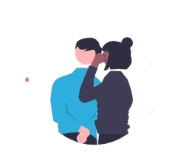
Go To Market
Digital Marketing
Pitching
Community Outreach and Events
Partnering with Estate Managers
Referral Programs

Slide 12
Social Impact
SDG3: Promote Good Health and Well-Being
We are committed to supporting healthy living and enhancing well-being by ensuring that residents in the Lekki area have convenient access to skilled artisans for essential home services. By connecting residents with trusted professionals for repairs, maintenance, and improvements, we help create safer, well-maintained living environments that contribute to overall comfort and peace of mind.

Slide 13
Our Ask
We are seeking N4 million to fund the initial 12-month phase of our project. Investors can expect a 12% return on their investment after two years
Services Needed
Amount Per Service in Naira
Project Registration
N 100,000
Website Deployment
N 900,000
Branding and Marketing
N 1,500,000
Customer Support
N 300,000
Product Launching
N 700,000
Product Maintenance
N 1,000,000
Total
N 4,000,000

Slide 14
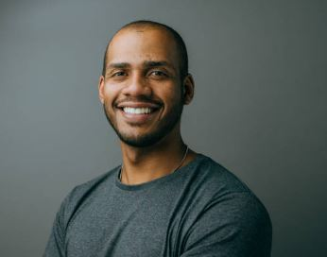

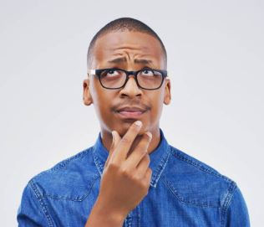

Team Members
Paul Madueke
Product Designer
Emmanuel Elem
Frond-End Developer
Ibukun James
Back-End Developer
Grace Anjorce
Marketer

Slide 15
Thank you !
Email: salaudinsuraj@gmail.com
LinkedIn
Portfolio

